Slide 1
Department of International Studies
DIS ENGLISH 1 – Week 12 – 20MAY2021

Slide 2
Week 13 schedule

Slide 3
1. Music Journal #9 - CC
Please write for ~15-20’ [~400w]

Slide 4
MJ#9 – cover songs
Compare-contrast two songs (Venn diagram).
I’ll play two songs today in class.
You can choose your own song from the folder (website) if you don’t like the two songs that are played in class. ☺

Slide 5
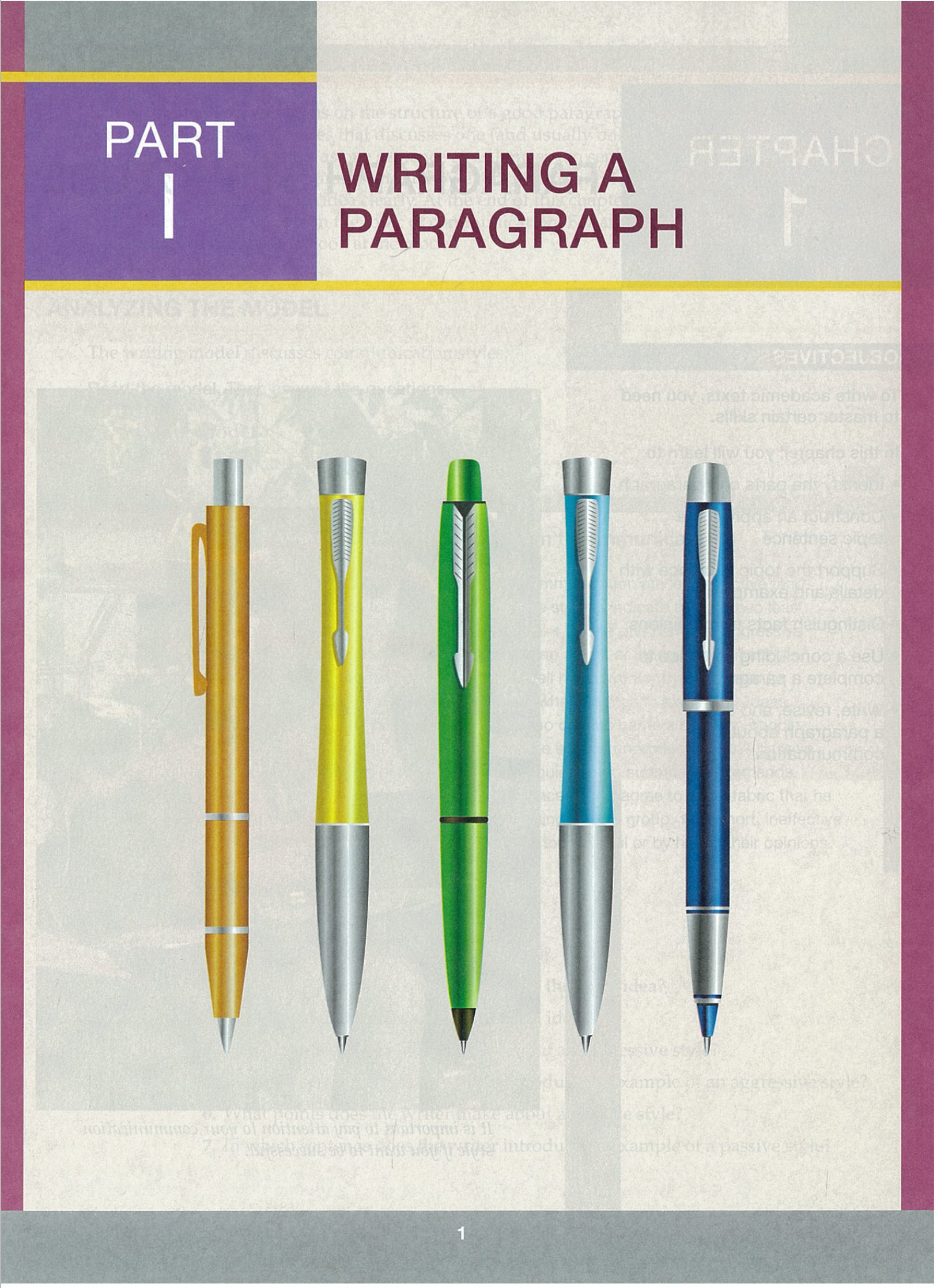
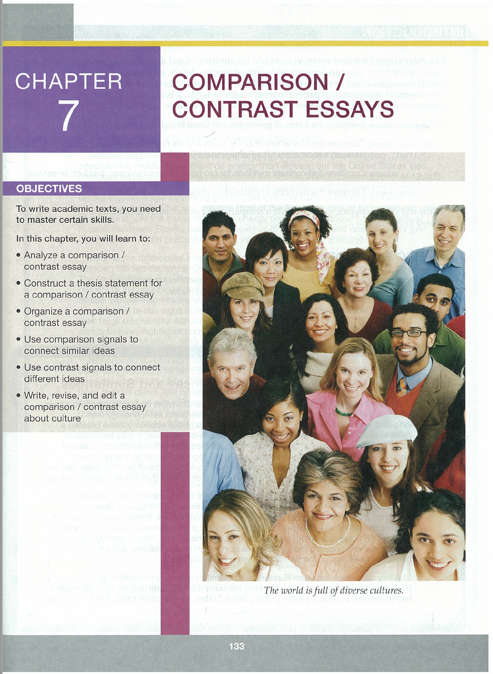
2. Chapter 7 Compare/Contrast Essays

Slide 6
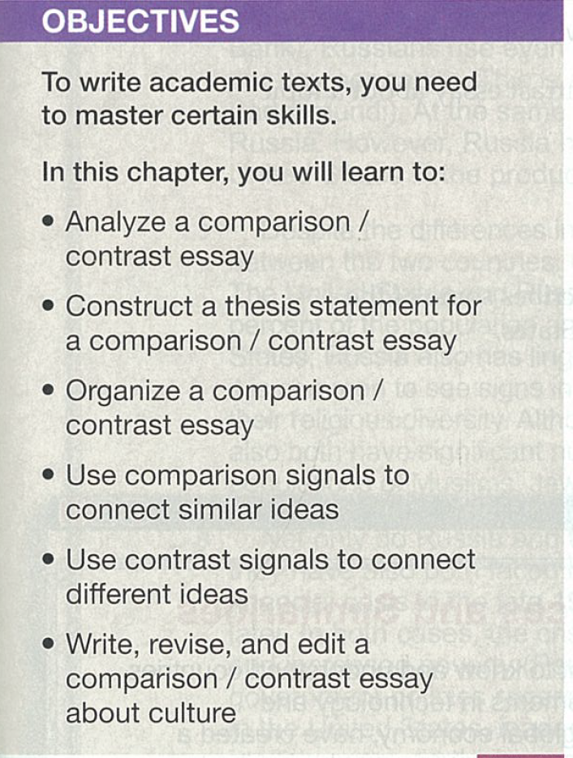
Chapter 7 - Objectives
Analyze a comparison / contrast (CC) essay
Construct a thesis statement for a CC essay
Organize a CC essay
Use comparison signals to connect similar ideas
Use contrast signals to connect different ideas
Write, revise, and edit a CC essay

Slide 7
Writing model (p. 134-135)

Slide 8
Writing model questions

Slide 9
Chapter 7 – Model answers

Slide 10
Chapter 7 – Practice 1

Slide 11
Chapter 7 – Practice 1 answers

Slide 12
Comparison / Contrast Chart (p. 137)

Slide 13
Point-by-Point Outline

Slide 14
Block Organization

Slide 15
Chapter 7 – Practice 2

Slide 16
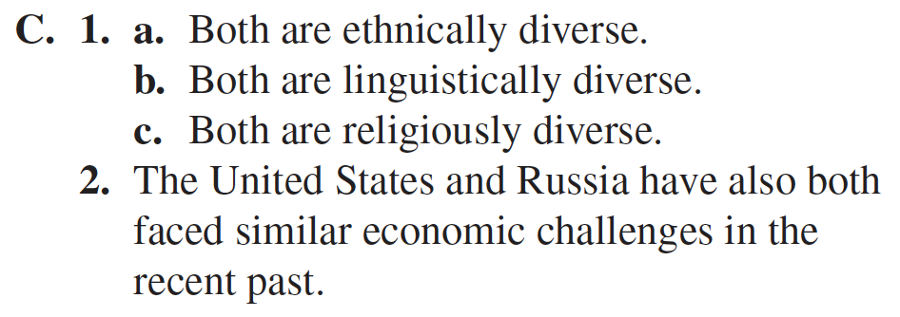
Chapter 7 – Practice 2 answers

Slide 17
CC Signal Words (p. 141)

Slide 18
Chapter 7 – Practice 3

Slide 19
Chapter 7 – Practice 3 answers

Slide 20
Chapter 7 – Practice 4

Slide 21
Chapter 7 – Practice 4 answers

Slide 22
Chapter 7 – Practice 4 answers (con’t)

Slide 23
Contrast Signal Words (p. 143-144)
TWO TYPES:
Concession Words
Direct Opposition

Slide 26
Chapter 7 – Practice 5

Slide 27
Chapter 7 – Practice 5 answers

Slide 28
Chapter 7 – Practice 6

Slide 29
Chapter 7 – Practice 6 answers

Slide 30
Chapter 7 – Practice 7

Slide 31
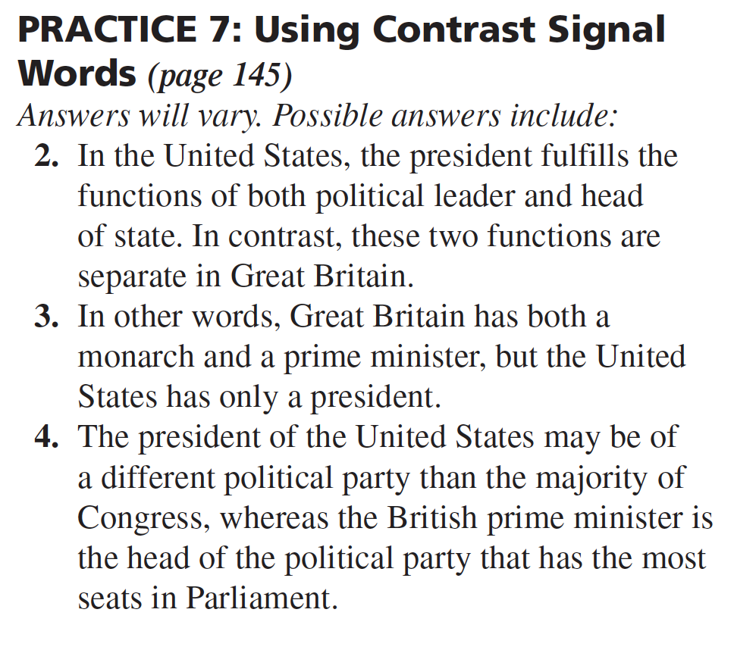
Chapter 7 – Practice 7 answers

Slide 32
Chapter 7 – Practice 7 answers (con’t)

Slide 33
Chapter 7 – Practice 8

Slide 34
Chapter 7 – Practice 8 answers

Slide 35
Website (www.toddmat34.com)
Let’s look at these files:

Slide 36
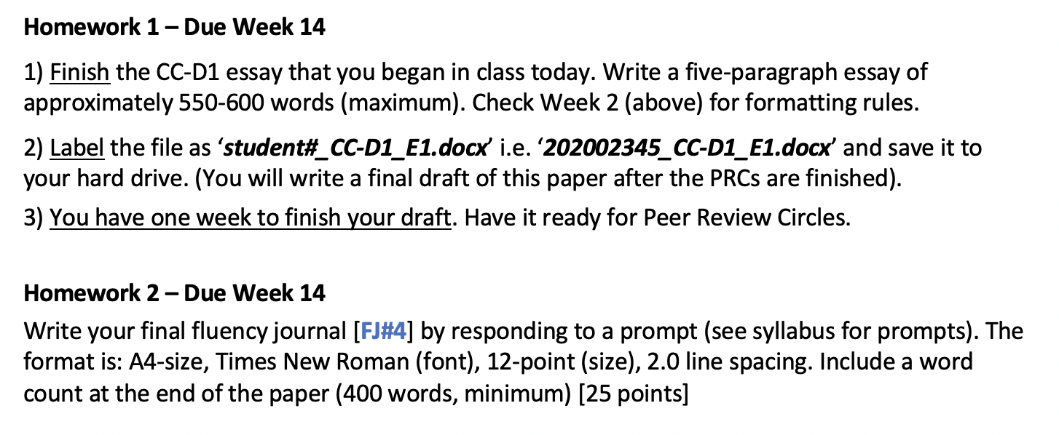
Homework – Due Week 14

