Slide 1
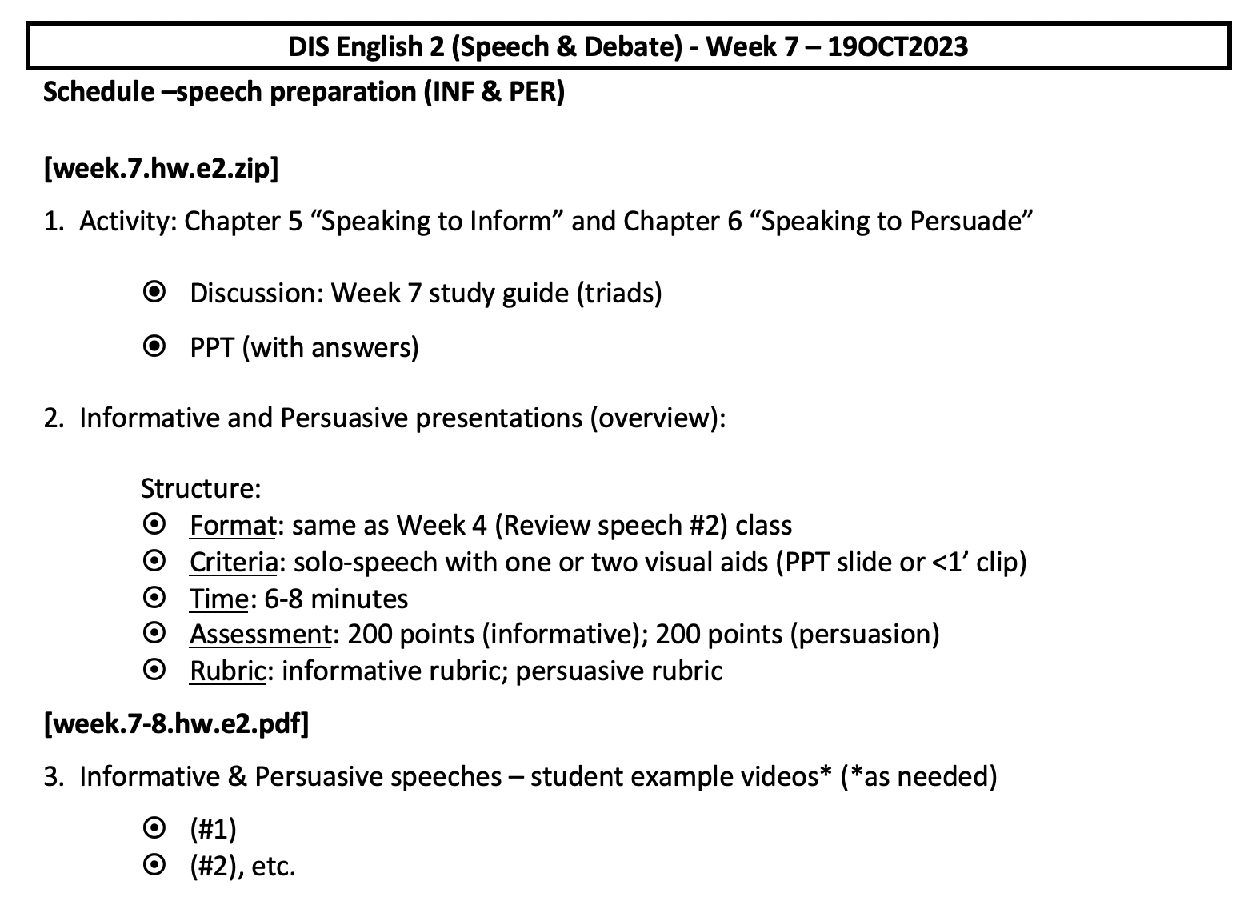
Week 7 schedule

Slide 2
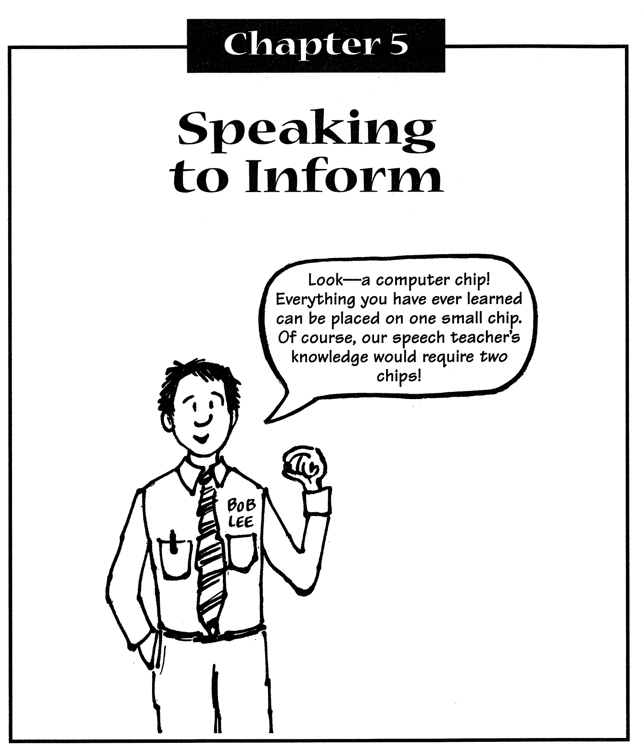
1. Homework discussion – Chapter 5

Slide 3
Q1-3 (definition, steps, & aspects)
1. What is an informative speech? What is the goal? (p. 64)
An informative speech is a speech that presents information to an audience (a report or summary, explanations, etc.) The goal is to state ideas simply, clearly, and interestingly, for understanding and remembrance (for audience retention).
2. What are the six steps for preparing an informative speech? (p. 65)
1) Analyzing your audience, 2) choosing your topic, 3) narrowing your topic, 4) gathering information, 5) preparing visual aids, and 6) organizing your speech
3. What five main aspects should you know about your audience?
The five aspects: 1) age range, 2) gender distribution, 3) occupation,
4) economic levels, and 5) general background.

Slide 4
Q4-6 (caution, 3 ways to choose, telling all)
4. What should a speaker avoid* (*2 items) when giving a speech? (p. 66)
Avoid statements (“girls” or “boys” for peers) that may offend your audience, and biased generalizations based on sex, occupation level, or general background.
5. What are three ways to choose a topic? (p. 67-68)
The three ways are: 1) choose something that you know a lot about and is interesting to you; 2) choose a topic for which you have special skills or work experience; 3) choose a topic about which you are knowledgeable
6. Why is telling everything you know about your topic a bad idea? (p. 68)
First, not all information about a topic can be given in a 5-minute* speech; second, your audience cannot remember too many details from one five-minute speech. (*note: our speech will be 6-8 minutes long).

Slide 5
Q7-9 (caution, 3 ways to choose, telling all)
7. What are three characteristics of a good informative speech topic? (p. 69)
The topic should: be specific (limited topic) , contain only one idea (one topic), and be achievable (the audience should be able to do, understand, or remember it afterward).
8. What are some ways to gather speech material? (p. 71-72)
Gather 1) within yourself (write what you know), and 2) outside yourself (do interviews and research – library or internet)
9. A) What are visual aids? B) Why should a presenter use them?
C) How are they helpful? (p. 73; 74)
A) Visual aids are: objects, models, pictures, charts, diagrams, and even physical demonstrations. B) They add variety, capture attention, illustrate concepts, and provide entertainment. C) Visual aids help your audience to actually see and experience what you are talking about.

Slide 6
Q10-11 (caution, 3 ways to choose, telling all)
10. What are six tips for using visual aids effectively? (p. 75)
The six tips are:
size – should be large enough for everyone to see
avoid passing out objects/papers during your speech (keep focus on you)
simplify charts, maps, and graphs, etc. (limit the details)
look at your audience, not at the visual aids (maintain eye contact)
remove visual aids after you have made your point
practice (when, where & how ) you will use them before delivery
11. What are the components of a good informative speech? (p. 75)
A hook, a preview, the body, a summary, and memorable concluding remarks.

Slide 7
Q12 (organizational patterns)
12. What are the eight organizational patterns for giving an informative speech? (p. 76-77)
1) Past-Present-Future (describe how smt once was/has changed/will be)
2) Time (how processes, events or activities happen; how to explain a process
3) Problem-Solution (use to speak about a specific problem and solutions)
4) Location (use to divide a topic into different geographical locations)
5) Cause-Effect (use to describe a particular situation and its effects)
6) Effect-Cause (use to describe a particular situation and its causes)
7) Related Subtopics (use to divide one topic into different parts)
8) Advantage-Disadvantage (use to talk about both +/- aspects of a topic
in a balanced, objective matter)

Slide 8
Q13-15 (organizational patterns)
13. What is the purpose of including a preview in a speech? (p. 79)
Tell your audience what you will cover before you actually begin the body of your speech. (“Tell ‘em what you’re gonna tell ‘em”)
14. What is important to do right at the beginning of your speech? What are four ways to do this? (p. 80)
Grab your audience’s attention/make them interested by: 1) asking a series of rhetorical questions; 2) telling a story; 3) stating a surprising fact; 4) stating a well-known quotation
15. What is the best way to summarize? (p. 81)
The best way is to remind your audience of what you said by repeating the main points covered in the body of your speech. (“Tell ‘em what you told ‘em”)

Slide 9
Q16-17 (organizational patterns)
16. What type of ending does every speech need? What are some ways to do this? (p. 81)
Every speech needs an ending that leaves the audience thinking about and remembering what was said > ask rhetorical questions, tell a story, state surprising facts, or use well-known quotations.
17. What five steps should a speaker prepare before giving an informative speech? (pp. 76-81)
  Prepare the body (Choose one of the eight organizational patterns)
  Prepare a preview (introduce the main points)
  Prepare a hook (question(s), tell a story, use a surprising fact or famous quotation, etc.)
  Prepare a summary (repeat the main points)
  Prepare memorable concluding remarks to leave the audience thinking and remembering what was said (rhetorical question, story, prediction, suggestion, opinion)

Slide 11
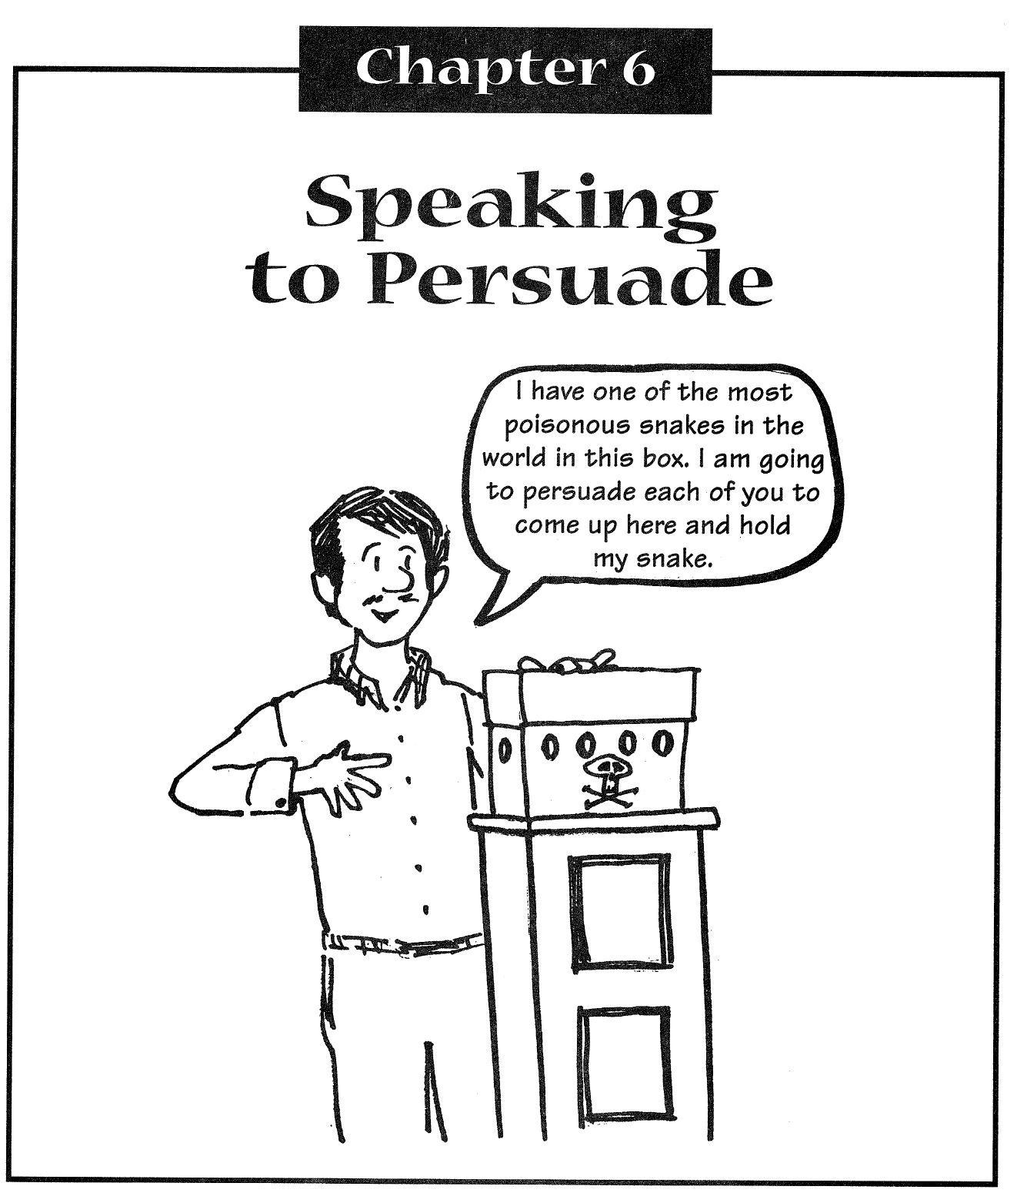
1. Homework discussion – Chapter 6

Slide 12
Q1-3 (definition, preparation, goal)
1. What is a persuasive speech? (p. 89)
Any speech used to convince others to change their feelings, beliefs, or behavior (i.e.; the goal is to change or influence others).
2. What are the six steps for preparing a persuasive speech? (p. 90)
The six steps are:
1) determining your specific purpose; 2) choosing your topic; 3) analyzing your audience; 4) gathering information; 5) preparing visual aids; 6) organizing your speech
3. What is the general goal of persuasive speaking? A first step toward this? (p. 91)
The general goal is to convince the audience to change something – a belief, an opinion, or their behavior. First, decide what you want the audience to change (a belief, an opinion, feeling, behavior, etc.)

Slide 13
Q4-5 (purposes, topic consideration)
4. What are the three specific purposes for which to convince an audience? (p. 92)
1) To change the audience’s belief that something is true or false (a reported fact is either true or false; something will or won’t happen; an event was represented accurately or inaccurately);
2) To the change audience’s opinion about something’s value (that something is good or bad, important or unimportant, fair or unfair, helpful/not helpful, etc,);
3) To change audience’s behavior: to either do something that are not doing now (should learn to scuba dive for a hobby, etc.) or to stop some behavior they currently practice (stop drinking coffee/cola).
5. What should one consider when choosing a topic? (p. 94)
A presenter should: 1) choose a topic that really interests her & that she feels strongly about; 2) suggest a little bit of a change in behavior, etc., not a complete change; 3) choose a topic that is controversial.

Slide 14
Q6-8 (audience analysis)
6. Why is audience analysis especially important? (p. 95)
It helps one to learn as much as possible about the audience’s feelings and opinions toward the presented topic > helps speaker prepare more effectively
7. What are three ways listeners may feel about a topic? (pp. 95-96)
Listener’s may: 1) agree completely (but if so, choose another topic); 2) be indifferent (if so, find a way to interest/convince/persuade them) 3) Disagree completely (if so, find out why in order to convince them that their reasons are not good).
8. [Review] What are two main ways to gather speech material? (p. 97)
Within yourself (write down what you know) and outside yourself (do online research, interviews, check editorials)

Slide 15
Q9-10 (definition, preparation, goal)
9. What are some examples of visual aids? Why should they be used? (p. 98)
Pictures, graphs, charts, survey results, diagrams, models, etc., or objects (real items related to your source) or even physical demonstrations. These can make a speech more interesting/help persuade the audience > the audience can see the importance of what you are describing.
10. What five steps should a speaker prepare before giving a persuasive speech? (p. 99)
Prepare an opener building on areas of agreement (build trust with the audience: focus on common goals, problems or experiences)
Prepare a statement of purpose (clearly state the specific purpose (thesis) of your speech)
Prepare the body (present evidence that will convince the audience to agree with you)
Prepare a summary (summarize presented evidence > ‘remind your audience why they agree with you’)
Prepare memorable concluding remarks (remind your audience why they should change a belief, opinion, or behavior)

Slide 16
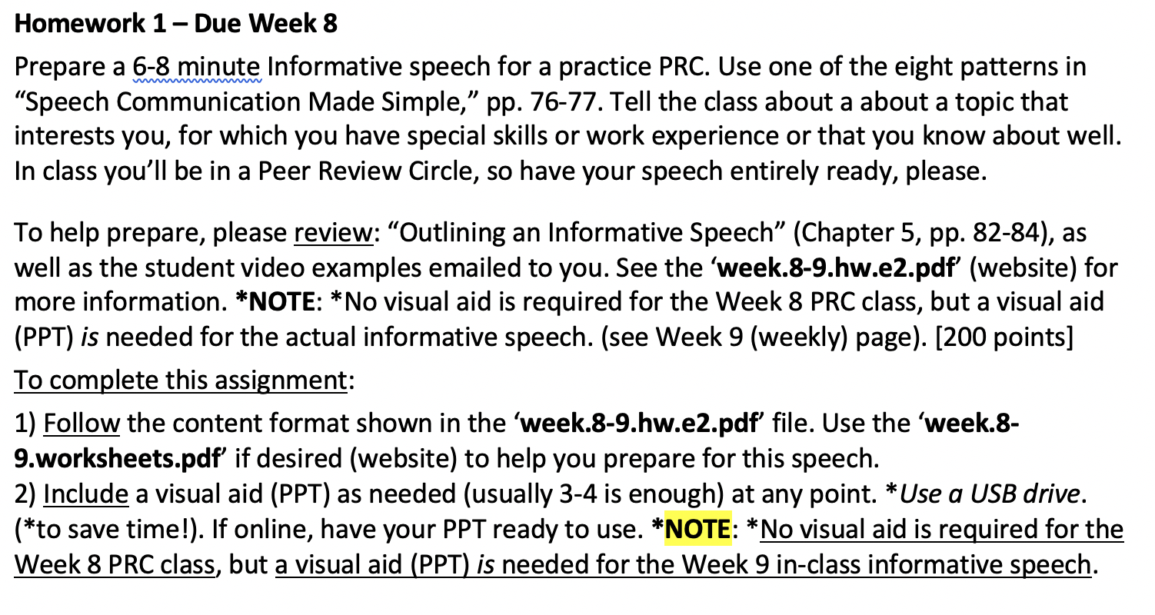
Homework – Due Week 8

