Slide 1
Department of International Studies
DIS ENGLISH 1 – Week 7

Slide 2
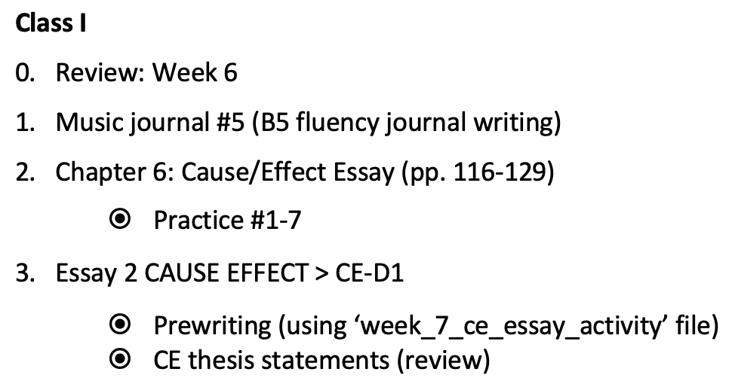
Week 7 schedule

Slide 3
1. Music Journal #4
Please write for ~15-20’ in a B5 journal/MS Word.
4. Midterm preview

Slide 4
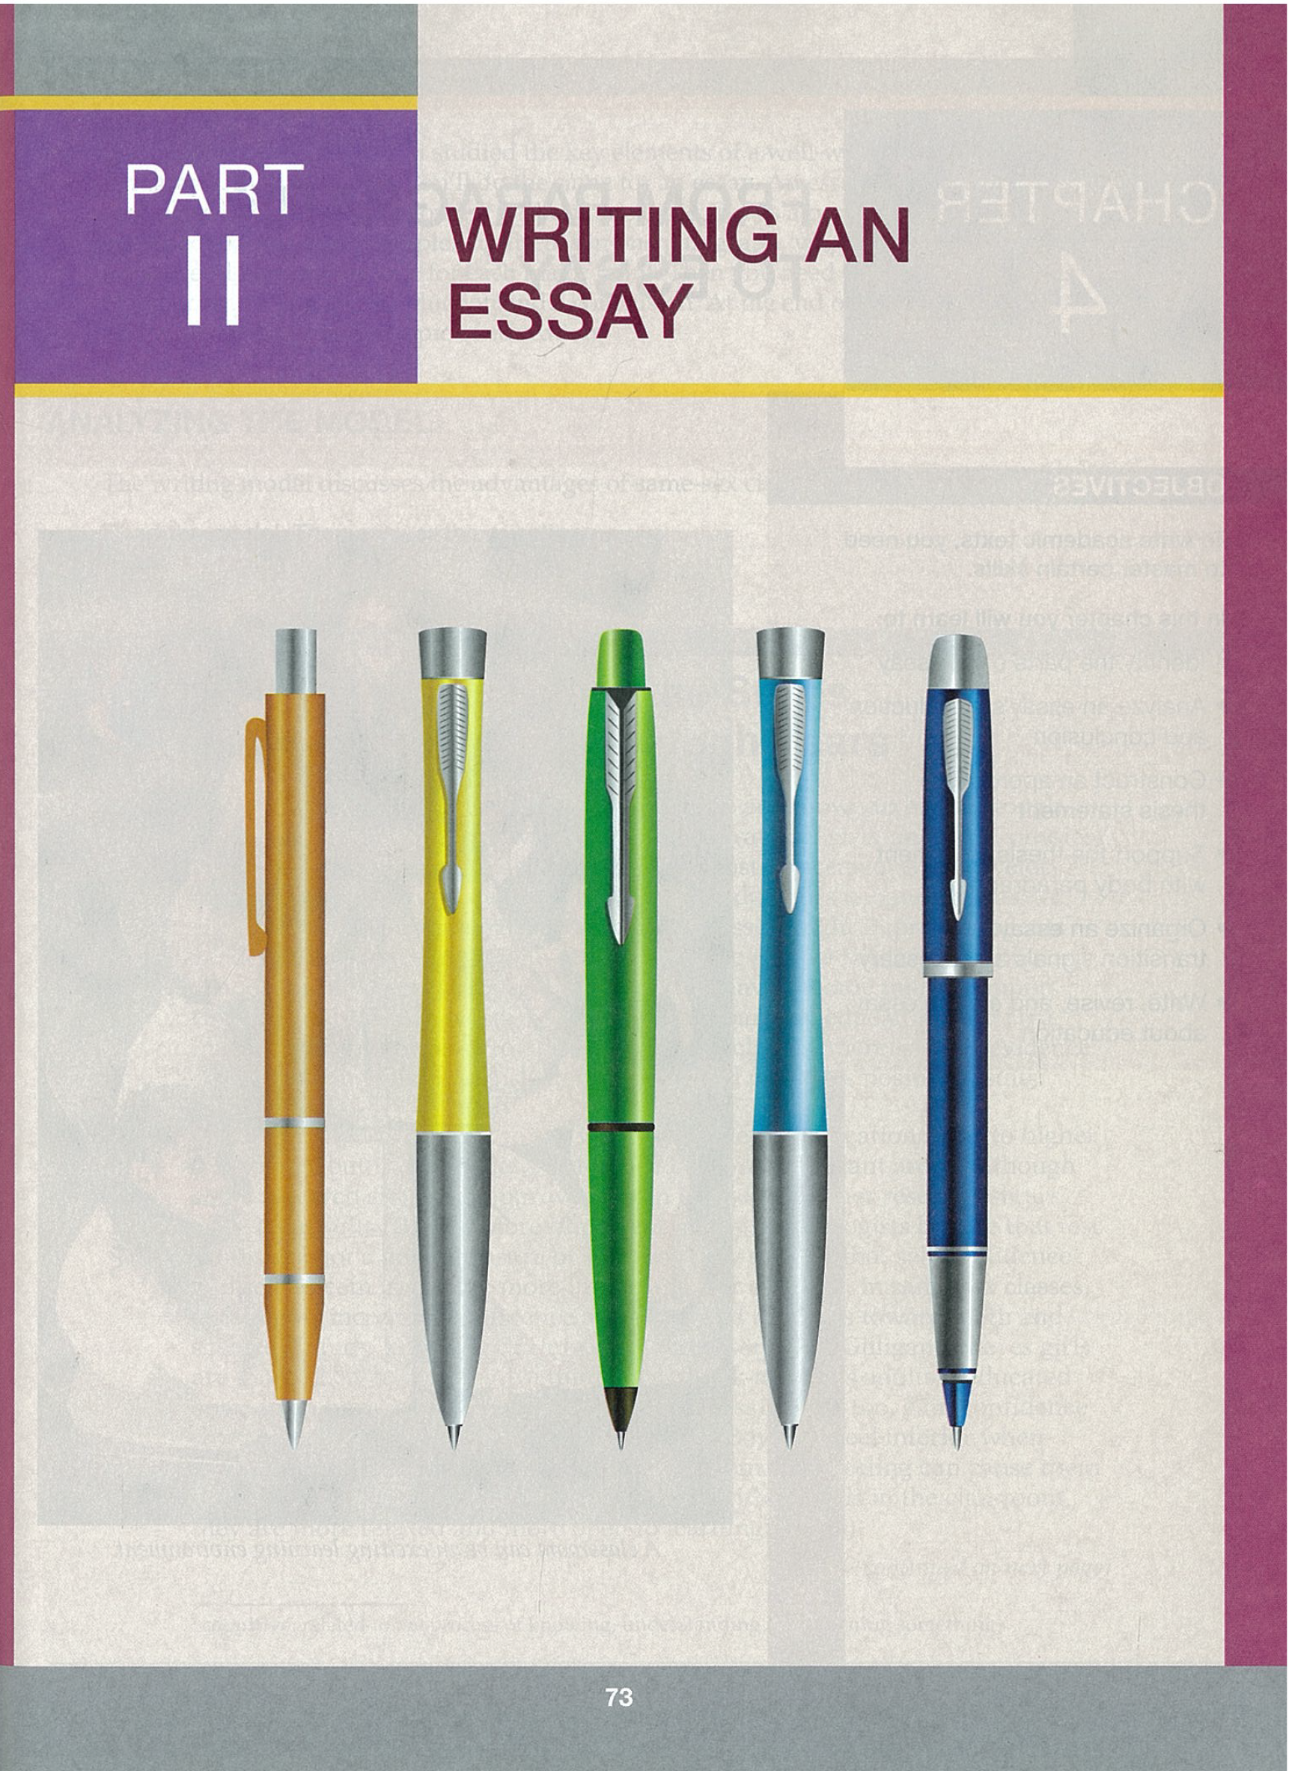
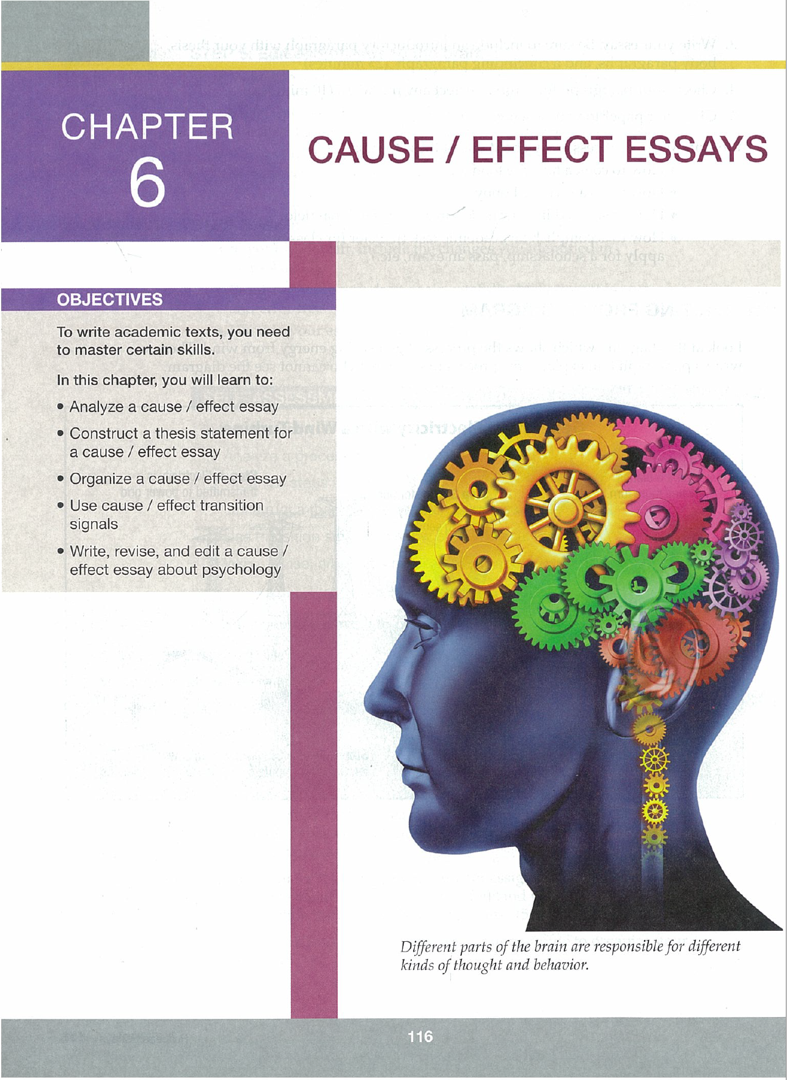
2. Chapter 6 – Cause / Effect Essays

Slide 5
Chapter 6 - Objectives
Analyze a cause/effect (CE) essay
Construct a thesis statement for a CE essay
Organize a CE essay
Use CE transition signals
Write, revise and edit a CE essay

Slide 6
Writing model 1 (p. 117-118)

Slide 7
Writing model 1 questions

Slide 8
Chapter 6 – Model 1 answers

Slide 9
Writing model 2 (p. 119-120)

Slide 10
Writing model 2 questions

Slide 11
Chapter 6 – Model 2 answers

Slide 12
Chapter 6 – Practice 1

Slide 13
Chapter 6 – Practice 1 answers

Slide 14
Organization

Slide 15
Chapter 6 – Practice 2

Slide 16
Chapter 6 – Practice 2 answers

Slide 17
Organization

Slide 18
Chapter 6 – Practice 3

Slide 19
Chapter 6 – Practice 3 answers

Slide 20
Transition Signals (p. 124-125)

Slide 22
Chapter 6 – Practice 4

Slide 23
Effect Signal Words (p. 126)

Slide 24
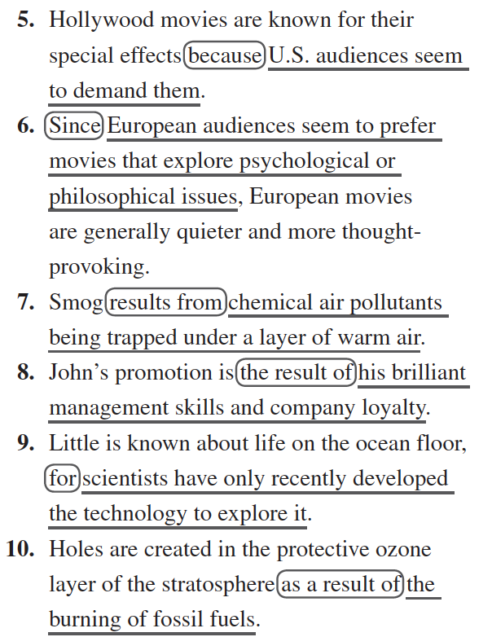
Chapter 6 – Practice 4 answers

Slide 25
Chapter 6 – Practice 5

Slide 26
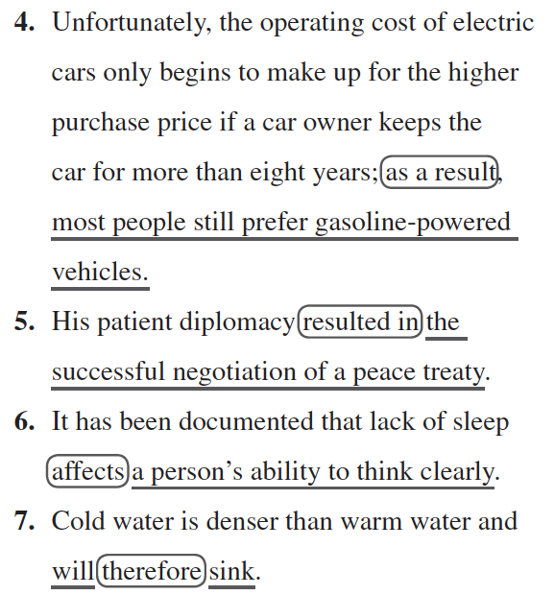
Chapter 6 – Practice 5 answers

Slide 28
Chapter 6 – Practice 6

Slide 29
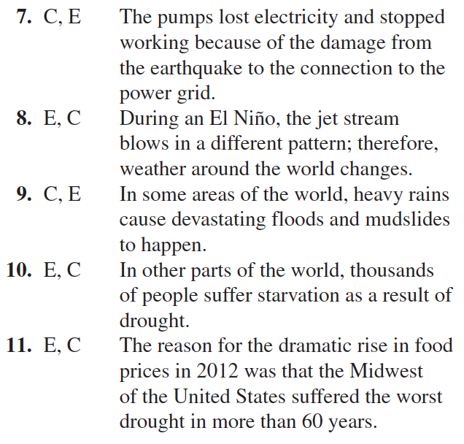
Chapter 6 – Practice 6 answers

Slide 30
Chapter 6 – Practice 7

Slide 31
Chapter 6 – Practice 7 answers

Slide 32
3. Essay 2 - CE
ce_essay_activity_file (website)
Prewriting (discuss with peers)
What are the causes or effects of CoVid-19?
How has it impacted you? (school/social/work life?)
ce thesis statement (review)

Slide 33
4. Midterm preview
Part 1: Chapter 1, 4, 5, and 9 (course book practice)
Part 2: short essay (~400 words about class processes)

Slide 34
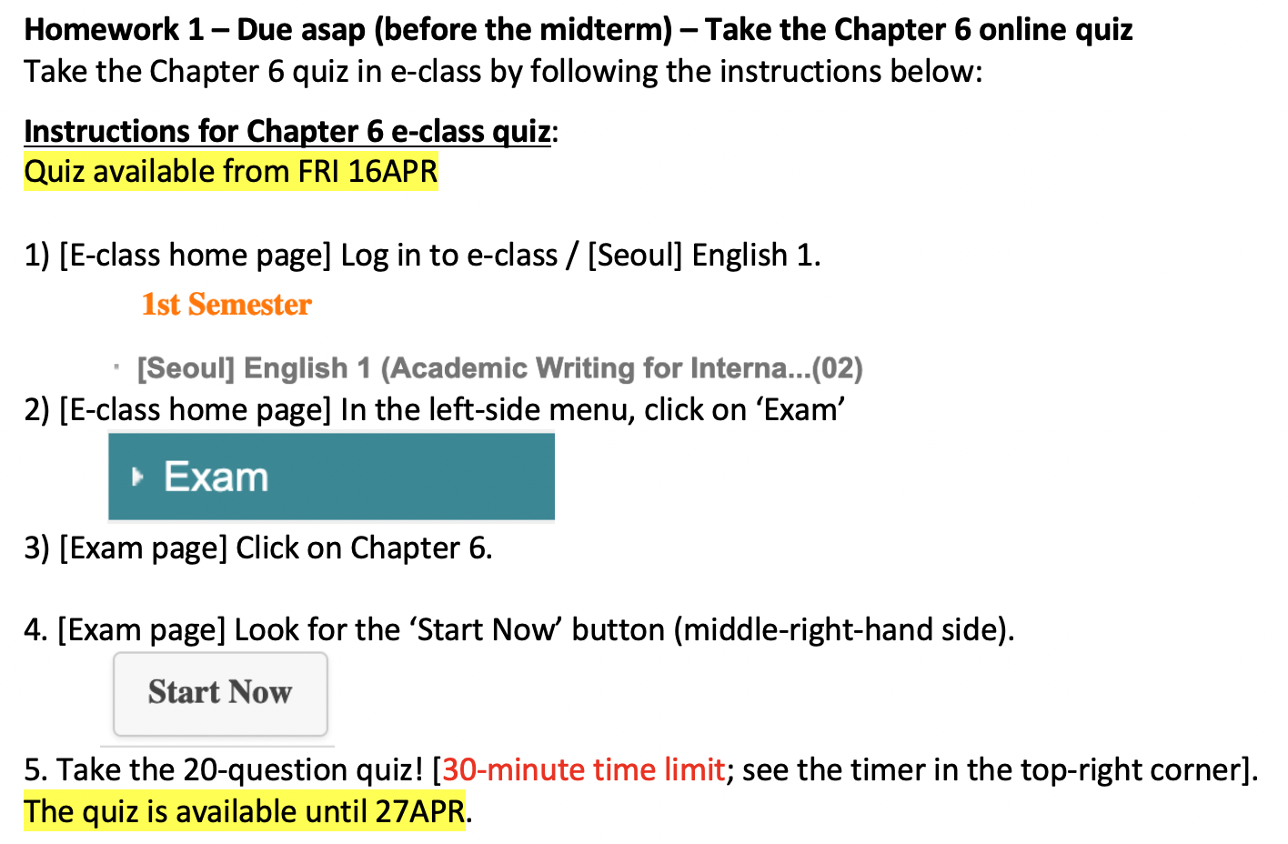
Homework – Due before the midterm

