Slide 1
Department of International Studies
DIS ENGLISH 1 – Week 6

Slide 2
Week 6 schedule

Slide 3
1. Music Journal #4
Please write for ~15-20’ in a B5 journal/MS Word.

Slide 4
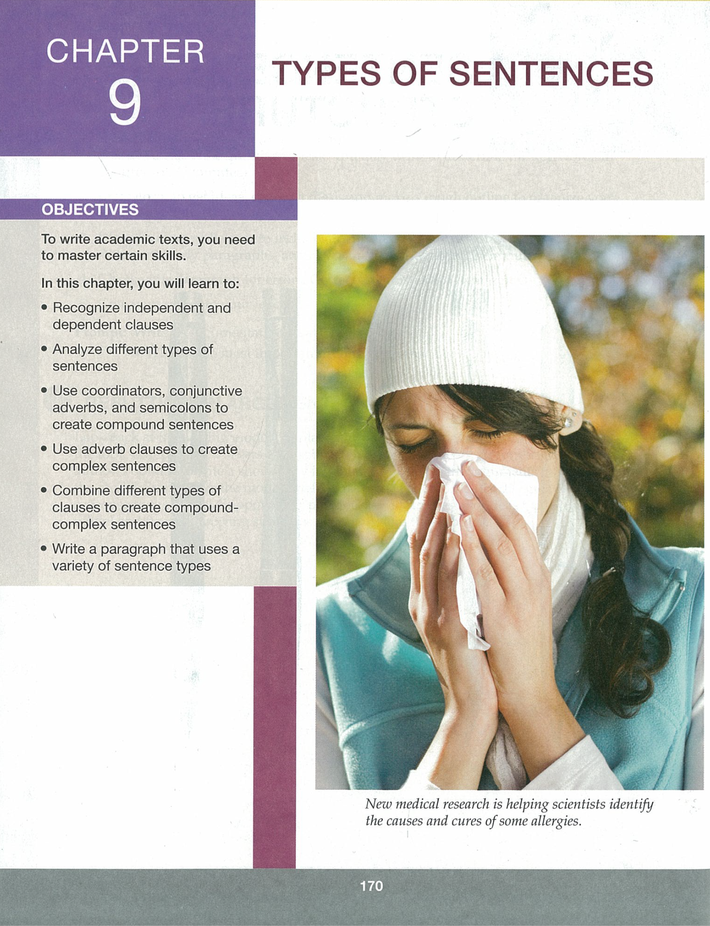
2. Chapter 9 – Types of Sentences

Slide 5
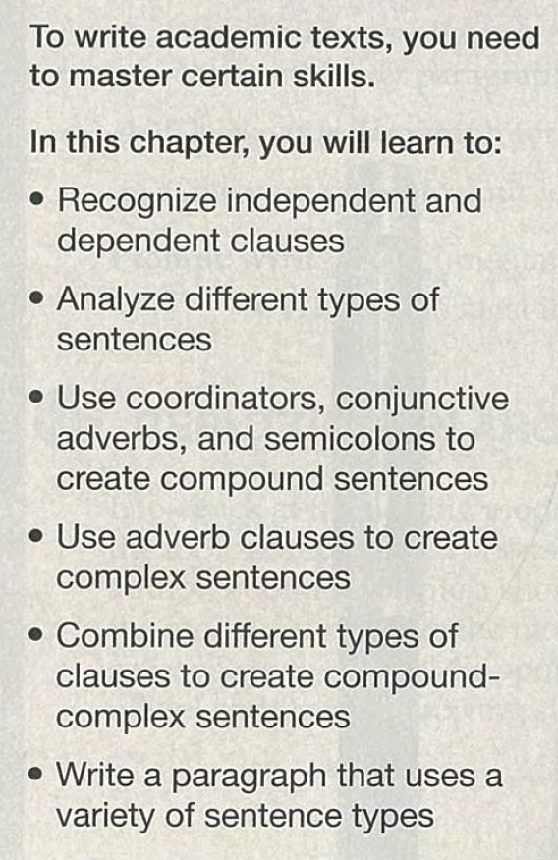
Chapter 9 - Objectives
Recognize independent and dependent clauses
Analyze different types of sentences
Use coordinators, conjunctive adverbs, and semicolons to create compound sentences
Use adverb clauses to create complex sentences
Combine different types of clauses to create compound-complex sentences
Write a paragraph that uses a variety of sentence types

Slide 6
Writing model (p. 171)

Slide 7
Draft 2

Slide 8
Writing model questions

Slide 9
Chapter 9 – Model answers

Slide 10
Chapter 9 – Practice 1

Slide 11
Chapter 9 – Practice 1 answers

Slide 12
Chapter 9 – Practice 2

Slide 13
Chapter 9 – Practice 2 answers

Slide 14
Chapter 9 – Practice 3

Slide 15
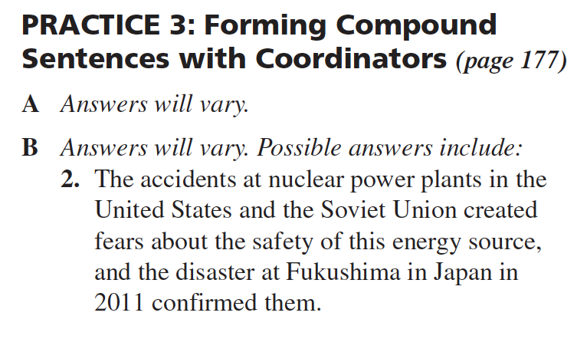
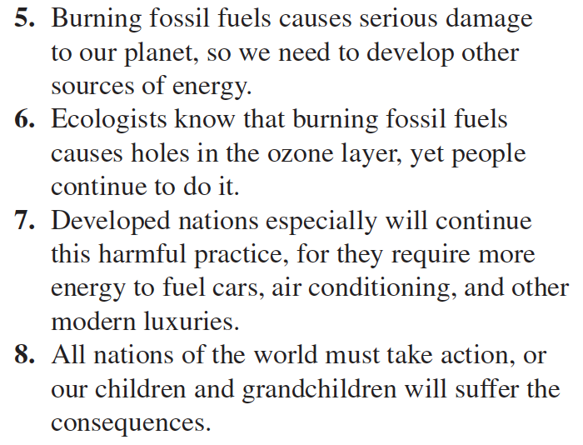
Chapter 9 – Practice 3 answers

Slide 16
Chapter 9 – Practice 4

Slide 17
Chapter 9 – Practice 5

Slide 18
Chapter 9 – Practice 5 answers

Slide 19
Chapter 9 – Practice 6

Slide 20
Chapter 9 – Practice 7

Slide 21
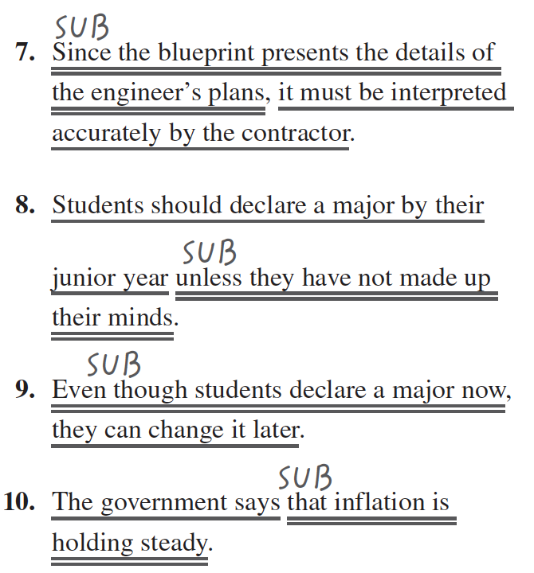
Chapter 9 – Practice 7 answers

Slide 22
Chapter 9 – Practice 8

Slide 23
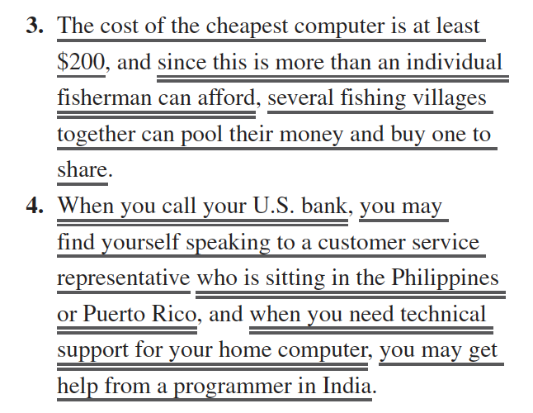
Chapter 9 – Practice 8 answers

Slide 24
Chapter 9 – Practice 9

Slide 25
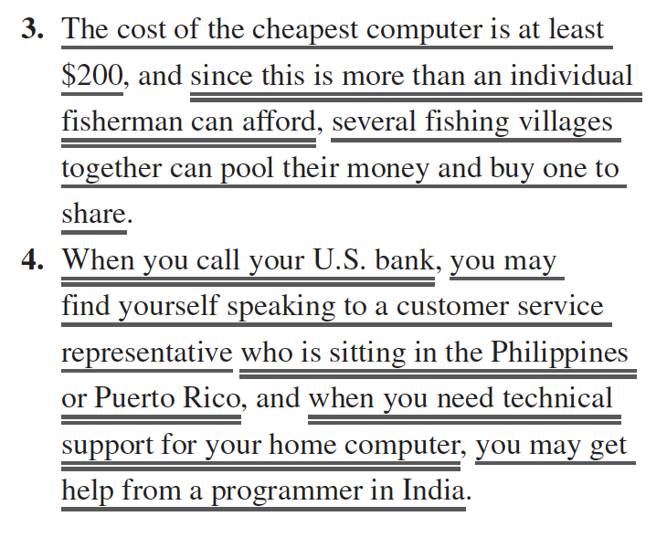
Chapter 9 – Practice 9 answers

Slide 26
3. Midterm preview
Part 1: Chapter 1, 4, 5, and 9 (course book practice)
Part 2: short essay (400-500 words about class processes)

Slide 27
Homework – Due Week 6 (see Weekly file for full details)

