Slide 1
Department of International Studies
DIS ENGLISH 1 – Week 10

Slide 2
Week 10 schedule

Slide 3
0. Midterm checking of answers
Let’s check answers and scoring

Slide 4
1. Music Journal #6
Please write for ~15-20’ in a B5 journal/MS Word.
4. Midterm preview

Slide 5
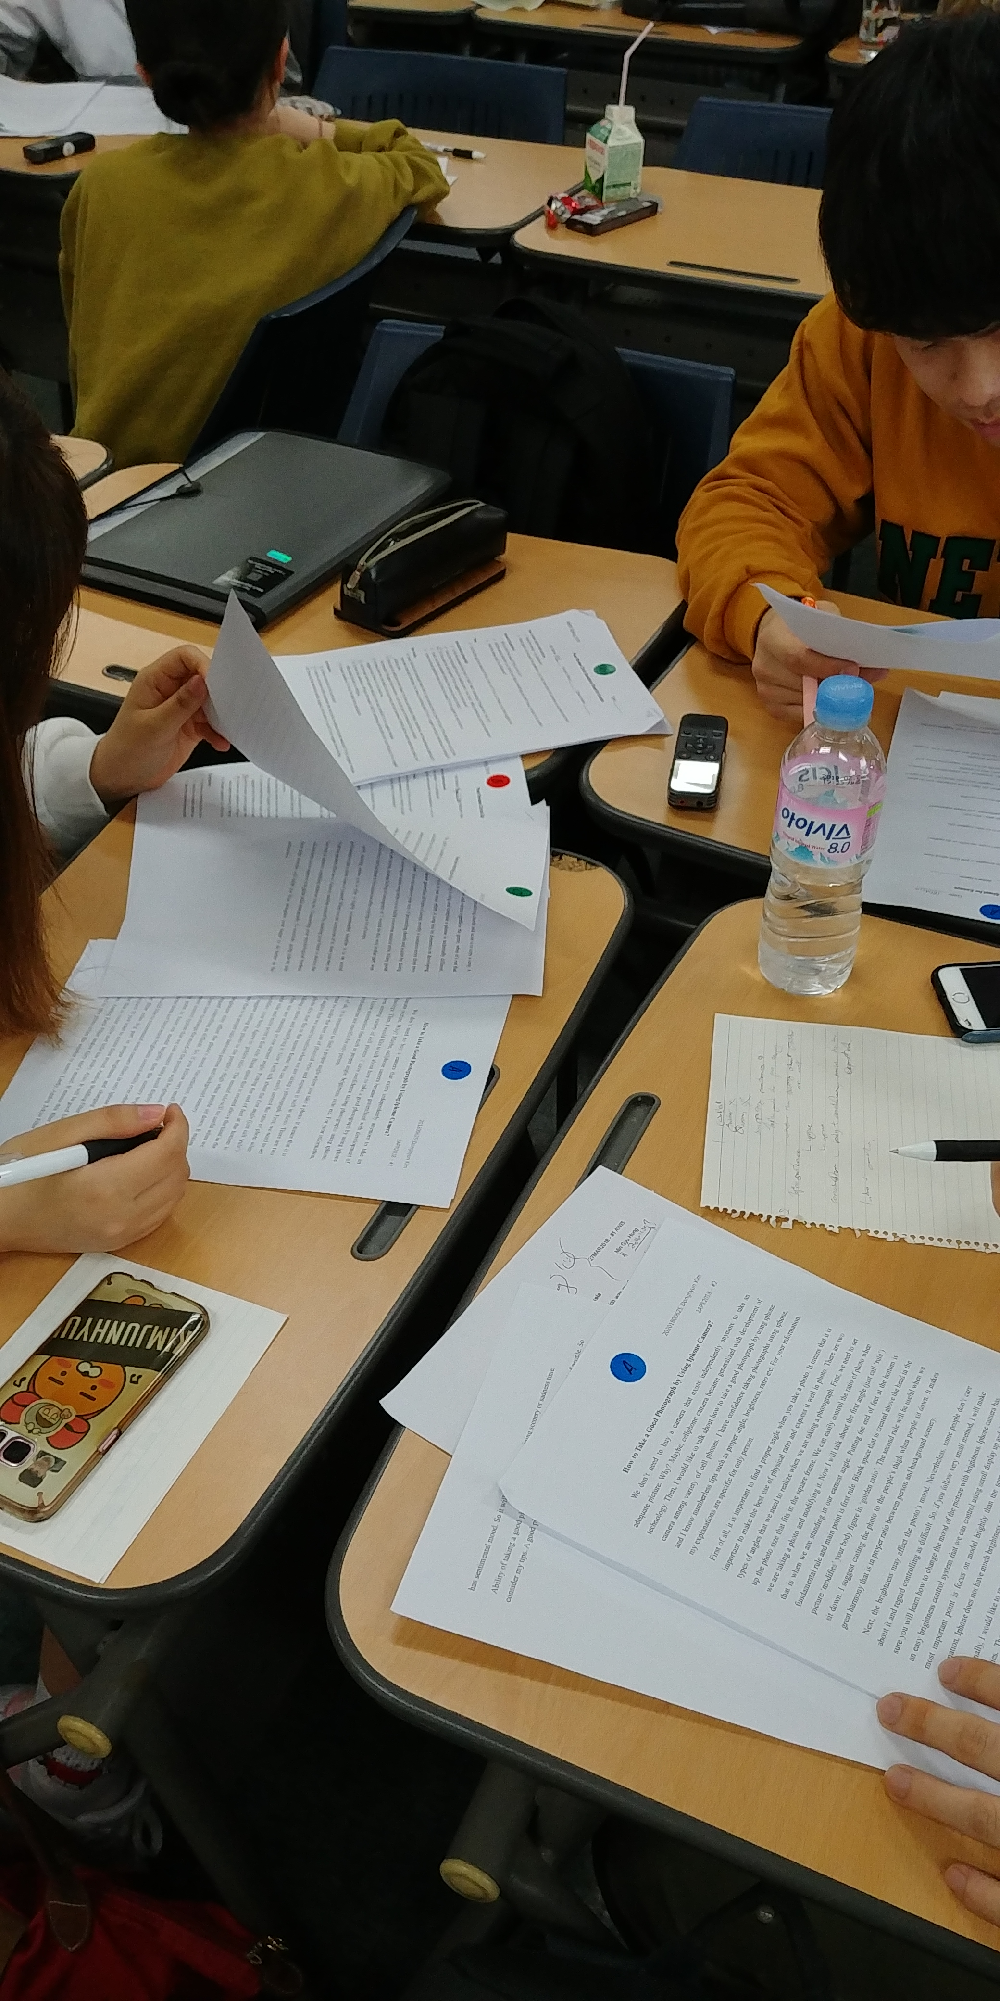
2. Peer Review Circles for CE-D1
Peer
Review
Circles
for essays

Slide 6
Preparation Step1: Get into groups
Notes:
Note if you have extra people, make groups of 4, but that group’s timing will be ‘off’

Slide 7
Preparation, step 2: Prepare your reader
On your own PRC Questions sheet:
Highlight several questions that you want the reader to give specific feedback on.
You may also write one or two questions for the reader to think about:
For example: “Is my second body paragraph too long?”
Or: “Can you suggest something to make paragraph 3 better?” etc.

Slide 8
Preparation part 3: Reading and Thinking (1’ prep and 5’ for reading both papers)
Label your essay copies with your letter, A, B, or C.
Upload a copy of your essay to each partner. Give your PRC sheet to the ‘main reader’ [C passes to A & B, etc.]
Read (skim) BOTH your partners’ papers quietly.
For one partner, make some notes on their PRC sheet.
Re-read the paper, paying special attention to the THESIS:
Is there a TOPIC + PLAN/ PREVIEW/MAP (A+B+C) present?
Is it one sentence?
Is it a statement and not a question?
If not, write one for them
Prepare to speak…

Slide 9
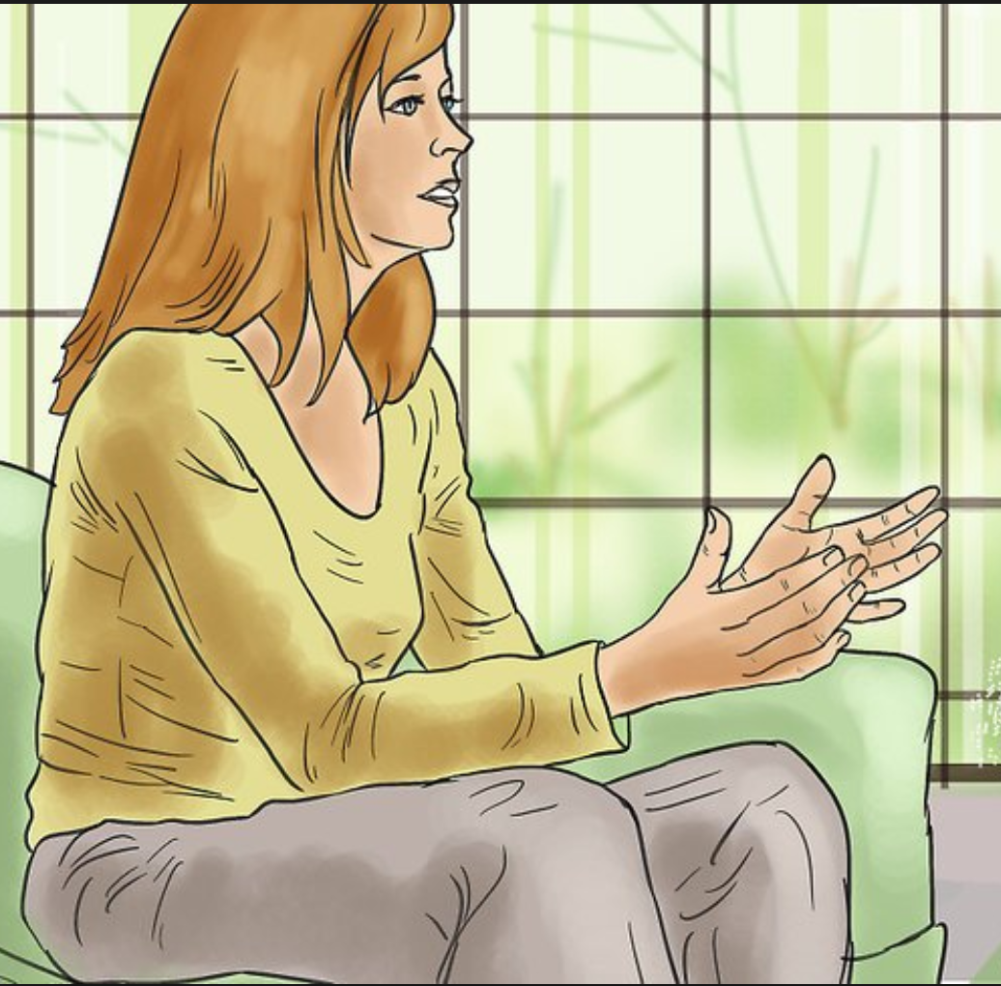
ROUND 1, step 1 (Reader’s 2-minute monologue)
A (reader)
A talks for 2 minutes to B (about C’s writing)
C (writer)
B (listener)
C listens and takes notes
C does not talk
B listens and
prepares to ask

Slide 10
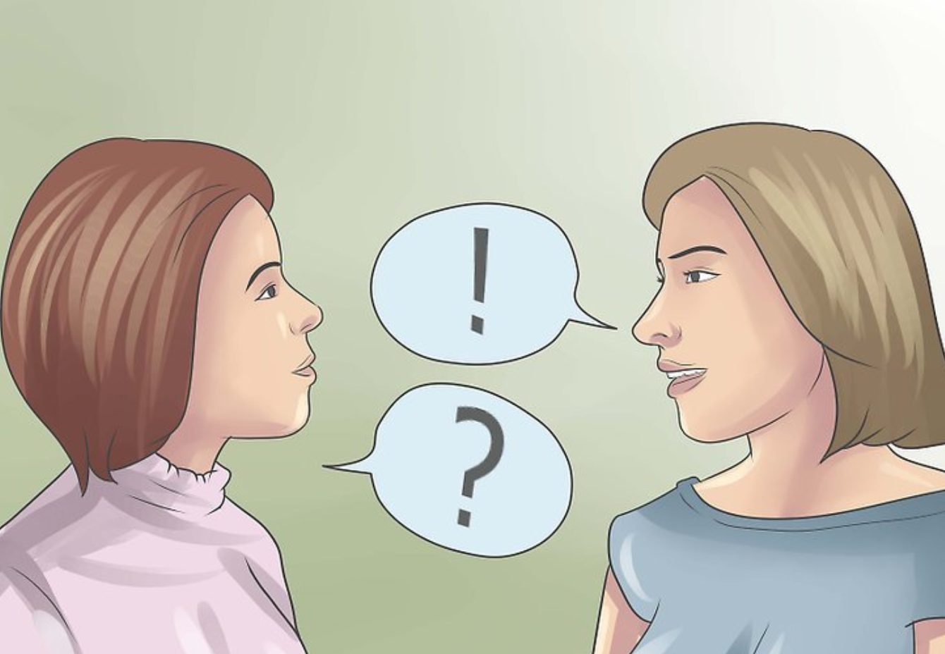
Round 1, Step 2 (Reader and Listener Q & A for 4 minutes)
A (reader)
B asks A questions about C’s writing, using the PRC sheet
as a guide
C (writer)
B (listener)
C listens and takes notes
C does not talk

Slide 11
Round 1, Step 3 (Writer responds and all members discuss for 4 minutes)
A (reader)
C (writer)
B (listener)
Three people discuss C’s writing.
C responds to what A and B said.
C can ask for more specific ideas or comment

Slide 12
Let’s read again (4’) (B and C skim over A’s paper))

Slide 13
ROUND 2, step 1 (Reader’s 2-min monologue)
A listens and takes notes
A does not talk
A (Writer)
C (listener)
B (Reader)
C listens and prepares to ask
B talks for 2 minutes to
C (about A’s writing)

Slide 14
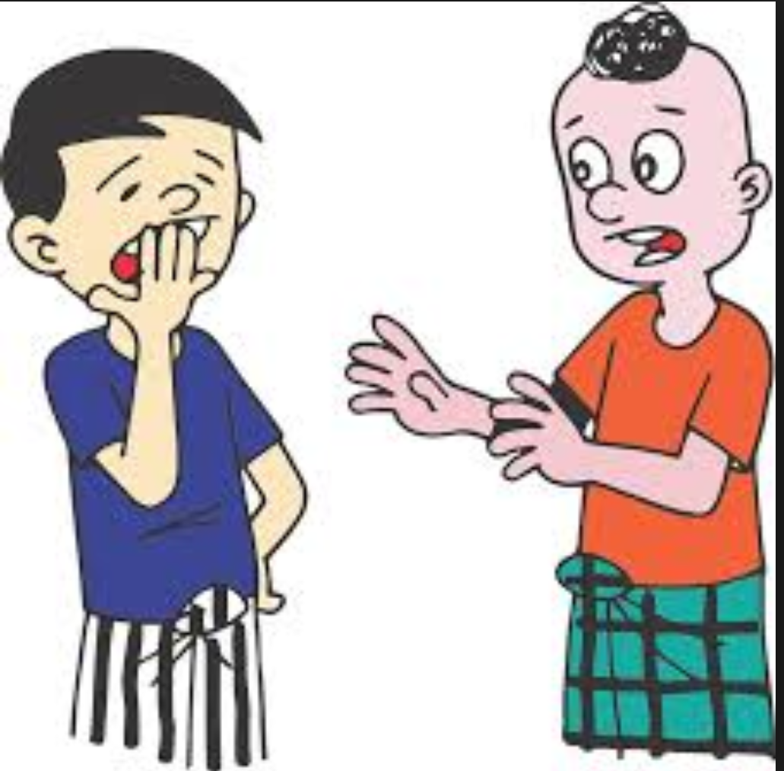
Round 2, Step 2 (Reader and Listener Q & A for 4 minutes)
A listens and takes notes
A does not talk
A
C
B
C asks B questions about A’s writing,
using the PRC sheet as a guide

Slide 15
Round 2, Step 3 (Writer responds and all members discuss for 4 minutes)
A
C
B
Three people discuss A’s writing.
A responds to what C and B said.
A can ask for more specific ideas or comments

Slide 16
Read once more (4’): A & C skim B’s paper

Slide 17
ROUND 3, step 1 (Reader’s 2-minute monologue)
A (Listener)
A listens &
prepares to ask
C (Reader)
B (Writer)
C talks for 2 minutes to A
(about B’s writing)
B listens and takes notes
B does not talk
Be sure to turn over the PRC Questions sheet when giving the monologue

Slide 18
Round 3, Step 2 (Reader and Listener Q & A for 4 minutes)
A asks C questions about B’s writing, using the PRC sheet as a guide
A
C
B
B listens and takes notes
B does not talk

Slide 19
Round 3, Step 3 (Writer responds and all members discuss for 4 minutes)
A
C
B
Three people discuss B’s writing.
B responds to what C and A said.
B can ask for more specific ideas or comments

Slide 20
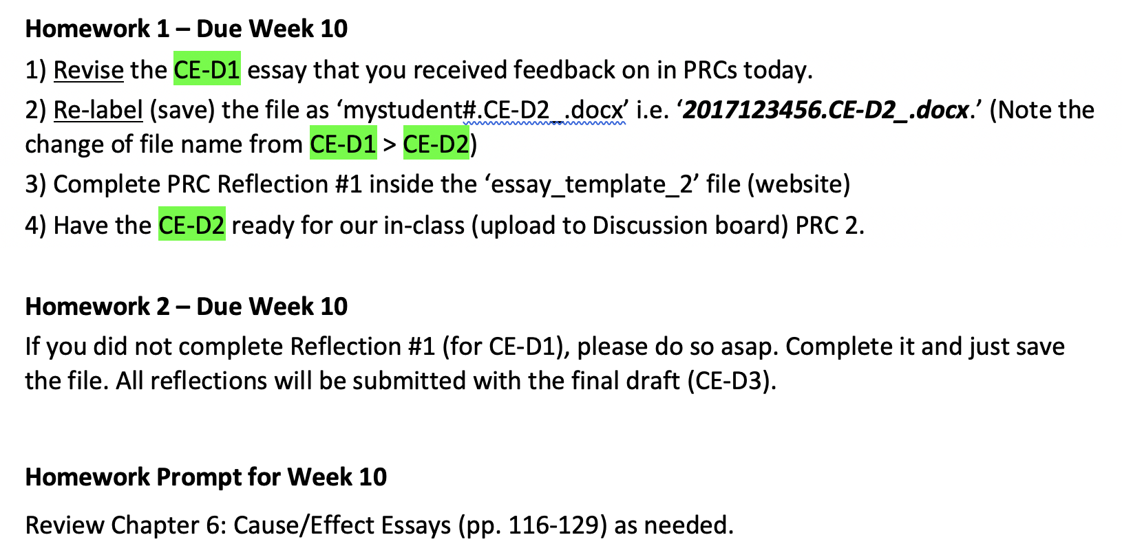
Homework – Due Week 11

Slide 21
Homework – Due Week 12 (con’t)

